Slide 1
Exploration of Donor Data
For the Prospect Researcher

Slide 2
Introduction
How can what we know about people who gave before be used to identify those who may give in the future? What characteristics can be identified and used to find currently unknown prospects?
We can only try to answer these questions using the data already collected in the donor database.
This study will explore a few variables to see how they might be used to model donor giving.

Slide 3
The TS Dataset
The dataset for this study is comprised of randomly sampled from a large database of known and potential donors. The variables chosen for this study were those easy to extract from the donor database without too much manipulation and have been shown in other studies to have some relationship to lifetime giving.
The variables are Lifetime Giving, Years of Giving, Assets, Record Type, Number of relationships, Gender, two Velocity Scores, Alumniu Code. Sports Code, Greek Code, Participation Score, Asset Class, and Participation Class.
Each will be explored in turn.

Slide 4
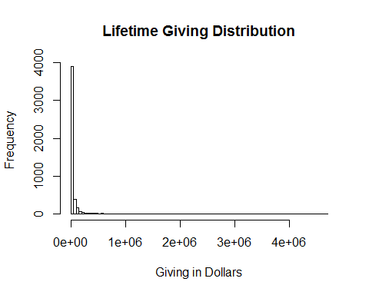
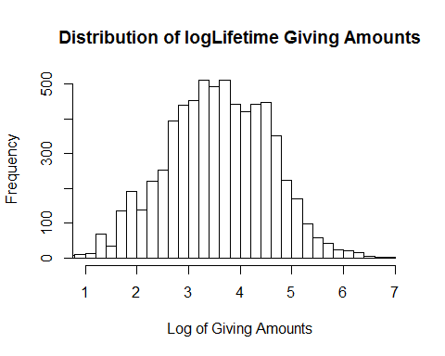
Lifetime Giving – the dependent variable
. The values represented by this variable range from $0 to over $9,000,000. This range makes creating a histogram to show the distribution unweildy.
Many of the methods I intend to use require that the data be normally distributed. By transforming this data using a log10 transform, the data takes on a normal distribution.

Slide 5
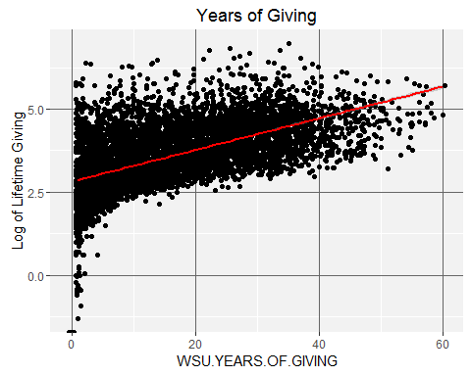
Years of Giving
It is to be expected that giving over long amounts of time adds up to a large amount over a lifetime, and this plot does show that positive relationship. But there are enough points well above the line to say that many years of giving is not likely to be a requirement for large gifts.
Years of Giving will not be included in the regression model,
A recommendation for future research is that this variable be examined in more detail. It is not necessarily true that the longer you have given, the more you have given. Size of the gifts through the years would make a great difference in cumulative giving, for example.

Slide 6
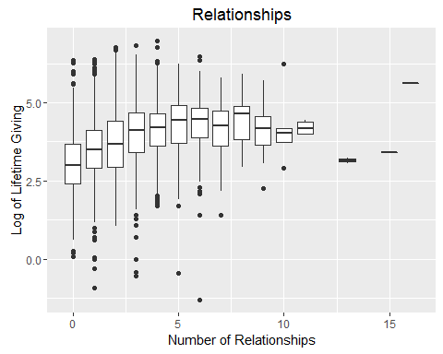
Number of relationships
This plot seems to indicate a correlation between lifetime giving and a low to moderate number of other family members who attended the university.
The variable Number.of.Relationships will be included in the regression model since it seems to have a relationship to giving based Kendall's rank correlation test.
A recommendation for future analyses is to separate this variable by type of relationship and look at each type independently from the others to see if any correlation exists.

Slide 7
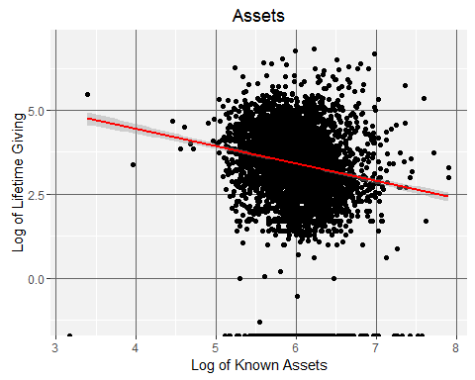
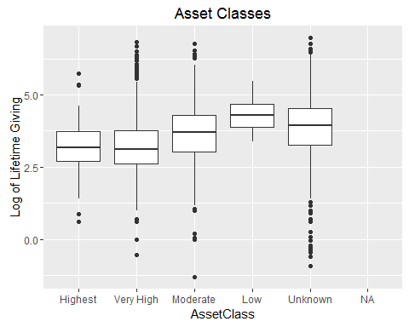
Assets
As with Lifetime Giving, the Asset variable was log transformed.
In order to better visualize asset data, it was broken up into 5 categories. The variable AssetClass will be included in the regression model to see if it is significant in relation to giving.

Slide 8
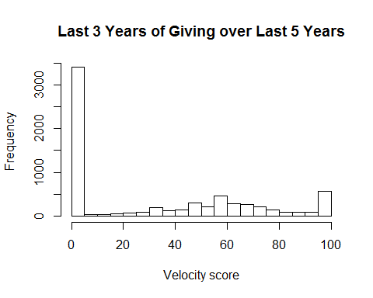
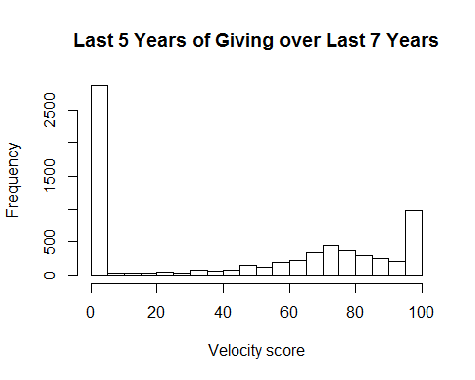
Velocity
The first method (the Velocity35Score) sums giving over the most recent three years and divides that number by the sum of giving for the past five years. This one will be used in the regression model.
The second method (Velocity57Score) sums giving over the most recent five years and divides that by the sum of giving for the most recent seven years.

Slide 9
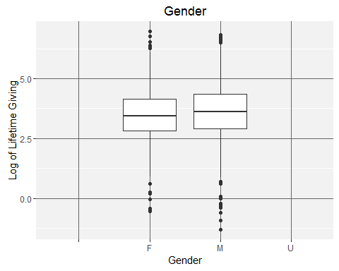
Gender
While the mean giving for males is slightly higher than that of females, this box plot does not show a great difference in giving related to gender.
Since it is unlikely to have any predictive value for giving, it will not be included in the regression model.

Slide 10
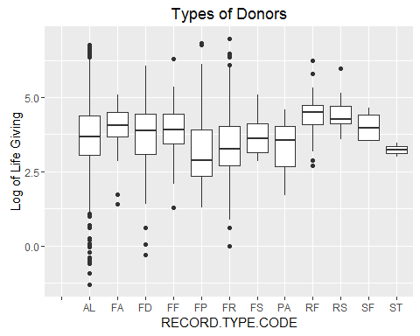
Types of donors (Record Type Code)
Alumni make up 63.8% of the TS sample. Combined with Friends, they account for 87.1% of the sample.
Alumni status might not appear to be influencing giving according to a Welch’s t-test, but the AlumniCode variable will be included in the regression model even though other variables may turn out to be more significant.

Slide 11
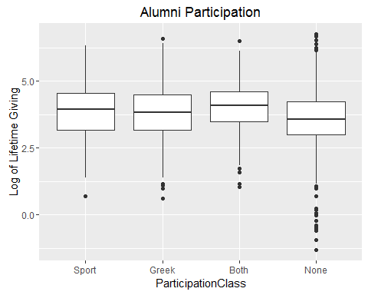
Participation in a sport or a Greek chapter
Welch's Two Sample t-test was performed on these variables to see if there was a meaningful difference between giving from those who participated in sports and those who joined a Greek chapter.
Both GreekCode and SportCode should not be expected to have a predictive influence on lifetime giving. But using both variables in the regression model is in agreement with literature discussing the effect on affinity on giving.

Slide 12
Putting it all together—The Regression Model
These seven variables are included: logGiving (the dependent variable), Number.of.relationships, AlumniCode, SportCode, GreekCode, Velocity35Score, and AssetClass, in a regression model.
RegMod <-lm(logGiving~Number.of.relationships+AlumniCode+ SportCode+ GreekCode+Velocity35Score+AssetClass2, data=TS)

Slide 13
Results
All of the variables had significance in terms of giving
Coefficients: Estimate Std. Error t value Pr(>|t|) (Intercept) 2.404509 0.034372 69.955 < 2e-16 *** Number.of.relationships 0.140236 0.007086 19.791 < 2e-16 *** AlumniCode 0.077489 0.025583 3.029 0.002465 ** SportCode 0.131743 0.049729 2.649 0.008088 ** GreekCode 0.100598 0.026849 3.747 0.000181 *** Velocity35Score 0.009697 0.000313 30.984 < 2e-16 *** AssetClass2 0.163537 0.008652 18.901 < 2e-16 ***

Slide 14
Recommendations for Future Analyses
Refine data used in this study. For example, break up the Number of relationships variable into separate categories and test parents and children against lifetime giving.
Look at more computed scores, such as Recency of first gift and Age at first gift.
Look for covariance among these variables.

Slide 15
Project Conclusions
Alumni standing and participation in sports or a Greek chapter did not have as significant an effect on lifetime giving as I expected.
Number of relationships turned out to be more influential on lifetime giving than I thought it would.
The graphs of most of the variables in the TS dataset pointed to some correlation, or lack thereof, with lifetime giving. They helped sort out variables like Gender that would not contribute to the model.
This study has been only a starting point in examining and understanding data that can be extracted from the donor database and exploring how it can be used to create a predictive model.

